Slide 1
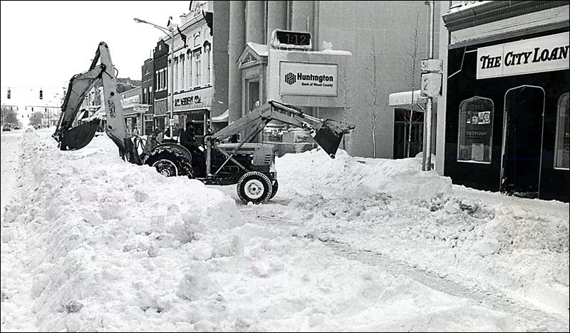
Blizzards
The most severe type of winter storm with winds over 35mph, reduced visibility, suspended snow, and heavy snowfall
Lucas Rollins, koala, June 4th 2015

Slide 2
Conditions during Blizzards
Weather conditions during the storm include, strong winds(over 35mph), heavy snowfall, low temperatures,(lower than
20°F and -6°C) reduced visibility(less than ¼ of a mile),blowing/suspended snow, traffic jams, power loss of power
(more than entire cities), frostbite, hypothermia, and in some cases, death.

Slide 3
Causes of Blizzards
The causes of blizzards is when precipitation falls to the ground in a path that is less than 0°C to the ground
in
seasons

Slide 4
Location and Timing
Blizzards can easily occur near large bodies of water(Lakes, Oceans)during the winter. It can also occur in very clod climates
The time of year is winter usually during January and February. Unless you live in a very clod climate with cold temperatures all year round.
The severe weather includes heavy snowfall, cold temperatures and strong winds

Slide 5
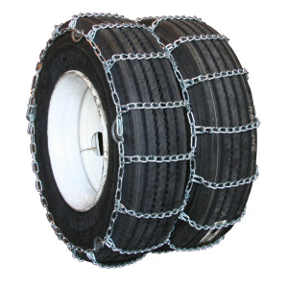
Safety Precautions
Dangers of the storm are…
35mph + winds
- 1/4 mile visibility
Multiple feet of snow fall
All for over three hours
Survival tips
Stock up on food
Use heaters and not fire (candles, fireplace)
Dress warmly, cover all parts of body(outside)
Use mittens not gloves
Bring chains and cables for car

Slide 6
Severity of Blizzards
+
Blizzard Watch
A watch for a blizzard is when these weather patterns can occur…
35mph+ winds
Reduced visibility (less than ¼ of a mile)
Temperatures lower than 0°C
Falling/suspended snow
All for over three hours
Warnings
FOR
hours

Slide 7
Severity of Blizzards
Blizzard warning
A blizzard will likely happen in the next 48 hours
High winds
Heavy snow
Falling/blowing/suspended snow

Slide 8
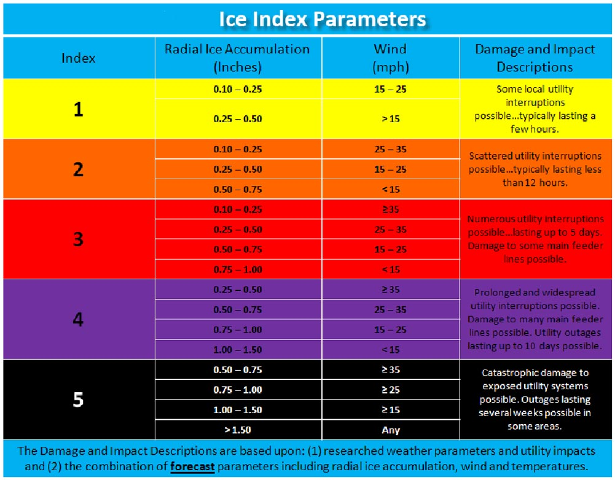
Ice Index Permanents
Level 1 Local utility interruptions
Level 2 Scattered utility interruptions
Level 3 Numerous utility interruptions
Level 4 Widespread utility interruptions
Level 5 Catastrophic utility interruptions

Slide 9
The Blizzard of 1888
It hit along the East Coast from Maine to Virginia
In New York, over 21 inches,(roughly two feet) of snow fell.
Power lines were downed
The stock exchange was closed for the first time ever
Snow fall averaged 40+ inches
Winds were between 50-70mph
Saratoga Springs ,New York, had 58 inches(roughly 6 feet) of snowfall!
The Blizzard killed 400 people, 200 in New York City.
Gravesend, New York had the highest snowdrift ever of 52 feet(16 meters)!

Slide 10
The Blizzard of 1888

Slide 11
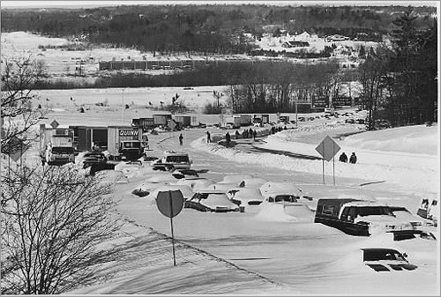
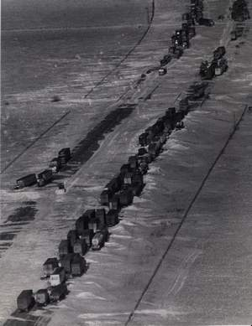
The Blizzard of 1978
The blizzard of 1978 was very similar to The Blizzard of 1888, killing only 100 people but lasting 3 days with record snowfall amounts around 27 inches in the northeast.

Slide 12
Bibliography
Englbert, Phillis. The Complete Weather recourse Volume 2:weather phenomena. Published in Detroit, London, New York, Toronto: U·X·L, 1997
Lloyd, Julie. WEATHER. Published in Florida: Parragon, 2007

Slide 13
See google slides videos

